Slide 1
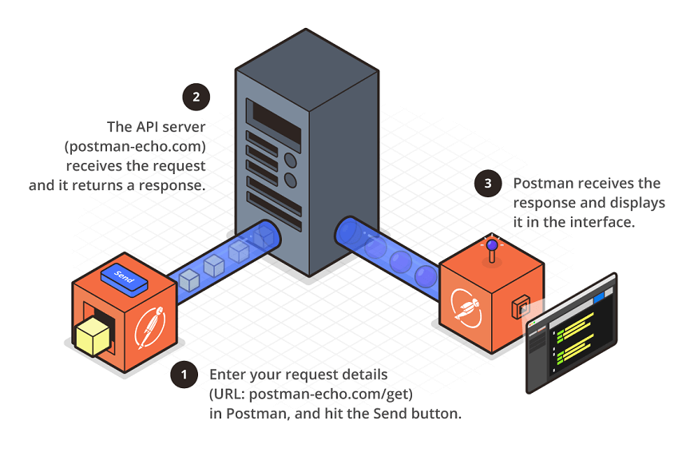
POSTMAN

Slide 2
What is Postman???
Postman is a standalone software testing API platform to test, design, modify, and document APIs.
It is a simple Graphic User Interface for sending and viewing HTTP requests and responses.
While using Postman, for testing purposes, one doesn't need to write any HTTP client network code. Instead, we build test suites called collections and let Postman interact with the API.
This tool has the ability to make various types of HTTP requests like GET, POST, PUT, DELETE.

Slide 3
Why Postman???
Accessibility- One can use it anywhere after installing Postman into the device by simply logging in to the account.
Use Collections-Postman allows users to build collections for their API-calls. Every set can create multiple requests and subfolders. It will help to organize the test suites.
Automation Testing-Tests can be performed in several repetitions or iterations by using the Collection Runner, which saves time for repeated tests.
Debugging- To effectively debug the tests, the postman console helps to track what data is being retrieved.
Collaboration- You can import or export collections and environments to enhance the sharing of files. You may also use a direct connection to share the collections.

Slide 4
GET vs POST Request
 | GET | POST
BACK button/Reload | Harmless | Data will be re-submitted (the browser should alert the user that the data are about to be re-submitted)
Bookmarked | Can be bookmarked | Cannot be bookmarked
Cached | Can be cached | Not cached
History | Parameters remain in browser history | Parameters are not saved in browser history
Restrictions on data length | Yes, when sending data, the GET method adds the data to the URL; and the length of a URL is limited (maximum URL length is 2048 characters) | No restrictions

Slide 5
GET vs POST Request
 | GET | POST
Restrictions on data type | Only ASCII characters allowed | No restrictions. Binary data is also allowed
Security | GET is less secure compared to POST because data sent is part of the URL Never use GET when sending passwords or other sensitive information! | POST is a little safer than GET because the parameters are not stored in browser history or in web server logs
Visibility | Data is visible to everyone in the URL | Data is not displayed in the URL

Slide 6
INSTALLATION

Slide 7
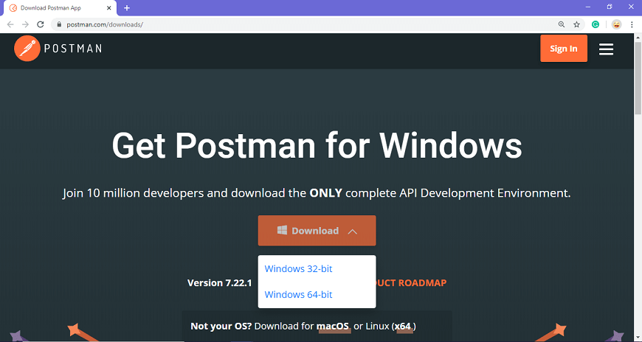
Step-1: Go to the link https://www.postman.com/downloads/ and click download for Mac or Windows or Linux based on your operating system.

Slide 8
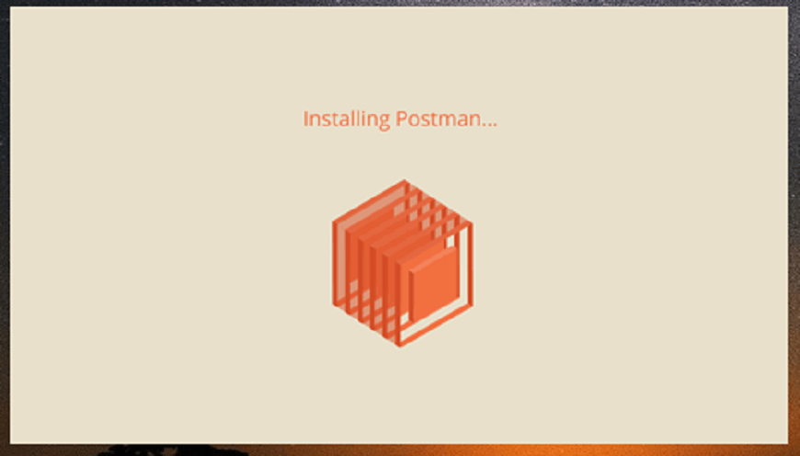
Step: 2- You can check the download progress on the bottom left if you are using the Chrome browser. Once the .exe file is downloaded, you need to install the application, as shown in the below image.

Slide 9
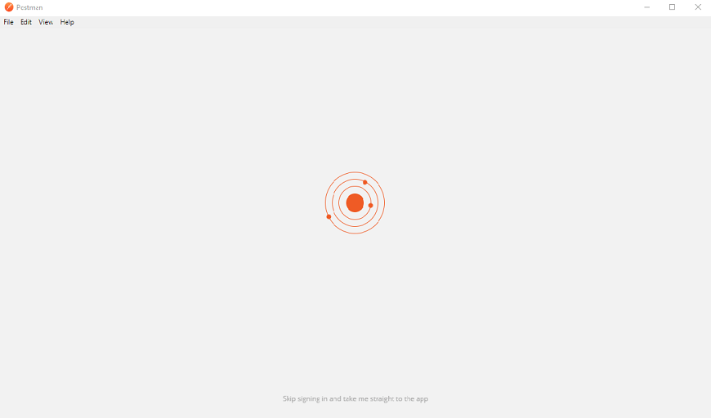
Step-4: Once the installation completes, you will be redirected to a window as shown in the image where you can click on Stop signing in and take me straight to the app (as this app can also be used without logging in) or otherwise you will get a new window to sign up.

Slide 10
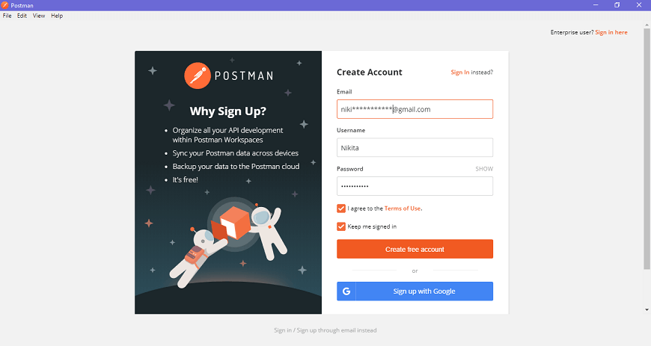
Step-5: Create your account with all the required details, or you can also signup with Google, as shown in the image.

Slide 11
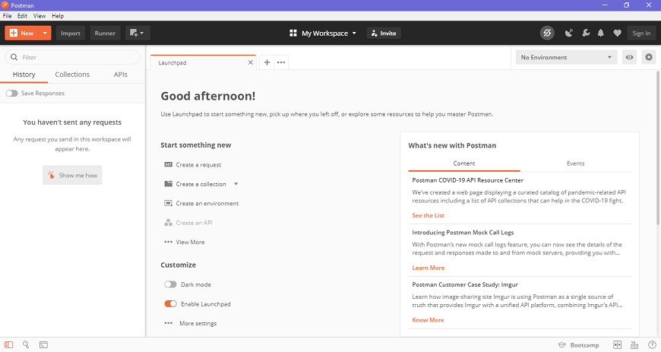
You will see the following page, and then you are ready to use Postman.

Slide 12
HOW TO USE POSTMAN???

Slide 13
We can split the postman navigation into four UI structures, as shown in the image below.
Header bar
Sidebar
Builder section
Response section

Slide 14
Builder Section
Untitled Request
'Untitled request' is basically the default request title you are working on. The title depends on the type of request method you are working on.
Request URL or Endpoint
This URL option is like any other browser URL. In this, we mention the link to where the API will communicate with.
Params
This option is used to write the parameters of the request. These parameters include key values and descriptions.
Authorization
The authorization process is required to access the APIs. This process verifies whether you have permission from the server to access the data you want. We will discuss this as a complete chapter tomorrow.

Slide 15
Headers
An HTTP request header is the additional data that is required to send along with the request. This header information is required for proper two-direction communication between the client and the server.
Body
It let you specify the data type that you need to send with a request. There are various types of body data that you can send to match your API.
Test scripts
It is executed during the request. It is also written in JavaScript. This helps you to ensure that API works as intended. Testing is important as it sets up checkpoints to verify whether the response status is ok and retrieved data is as expected.

Slide 16
LET’s START WORKING WITH POSTMAN

